Slide 1
Team ABeeSeesDee
Bryan Anders
Samir Ouahhabi
Sami Awwad

Slide 2
Game mechanics summary
4 classes: Warrior, Cleric, Rogue, Wizard
Strength, Dexterity, Intelligence, Wisdom
User can assign points to each stats upon creating his character
More stats to assign upon leveling up
Abilities can be learned upon leveling up
Items are randomly generated based on player’s current level
Inventory, equipment, consumables
Difficulty increases based on player level and number of players
Defeat room monsters and the final boss to win

Slide 3
Item

Slide 4
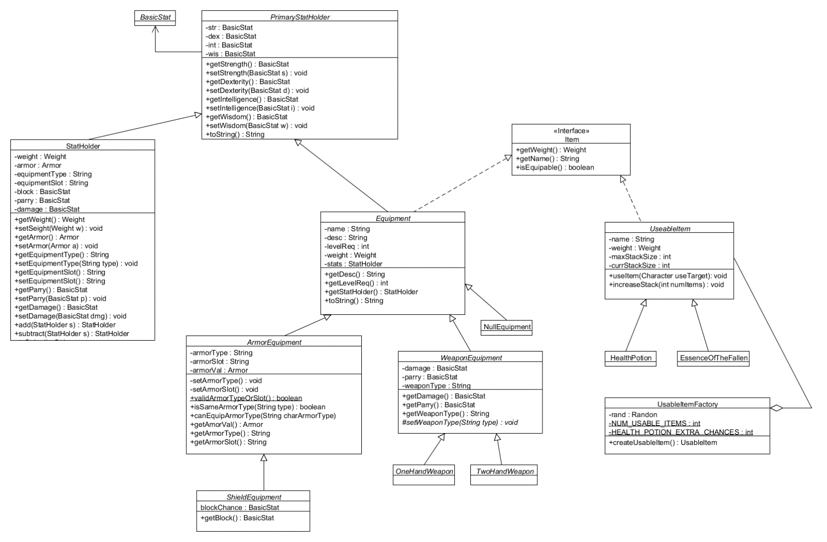

Slide 5
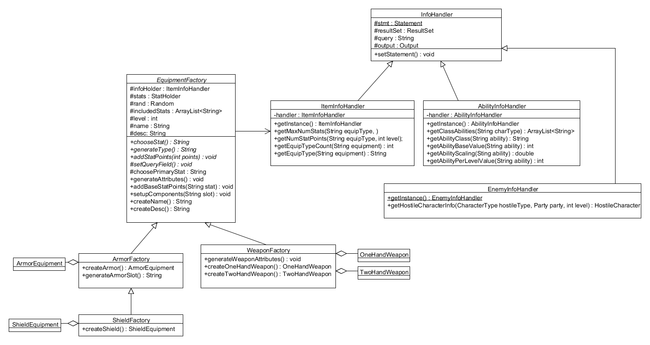

Slide 6
Abilities

Slide 7
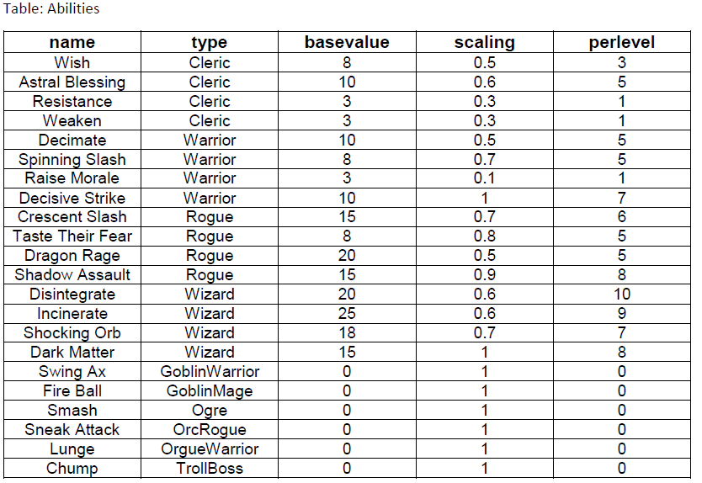

Slide 8
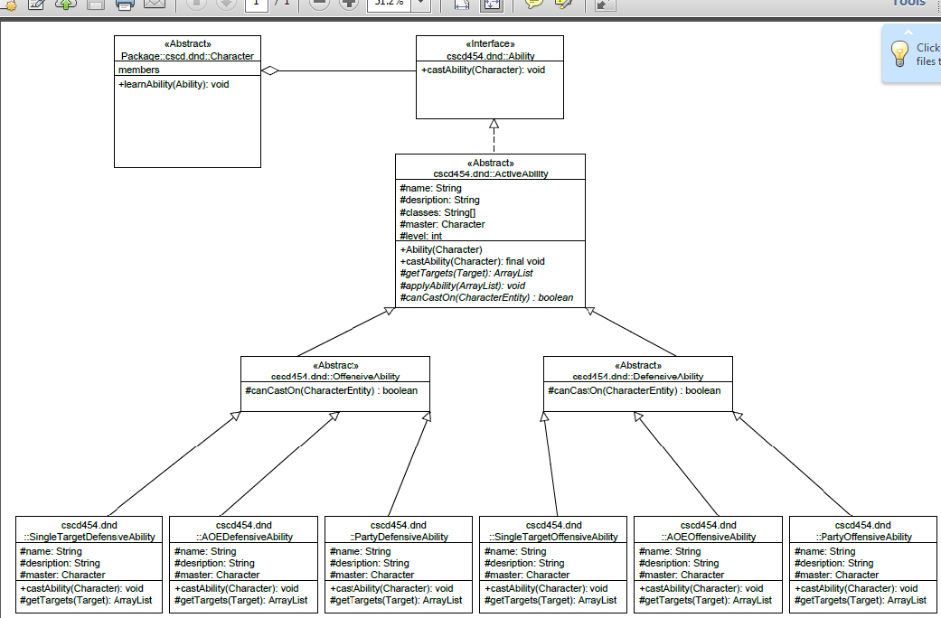

Slide 9
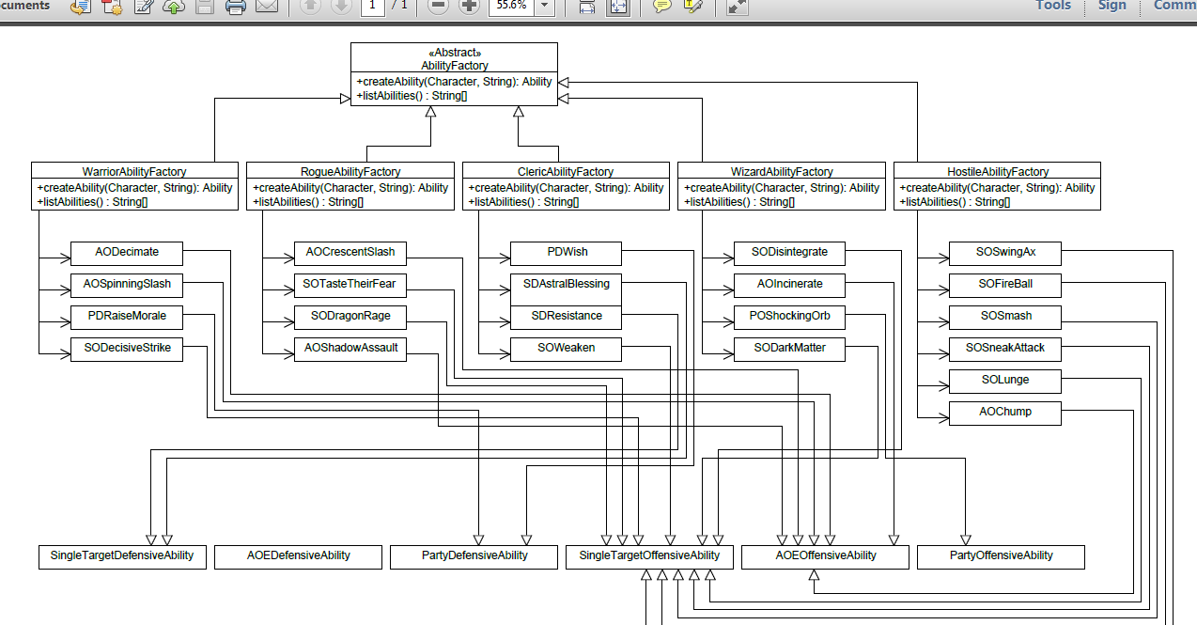

Slide 10
Game World

Slide 11
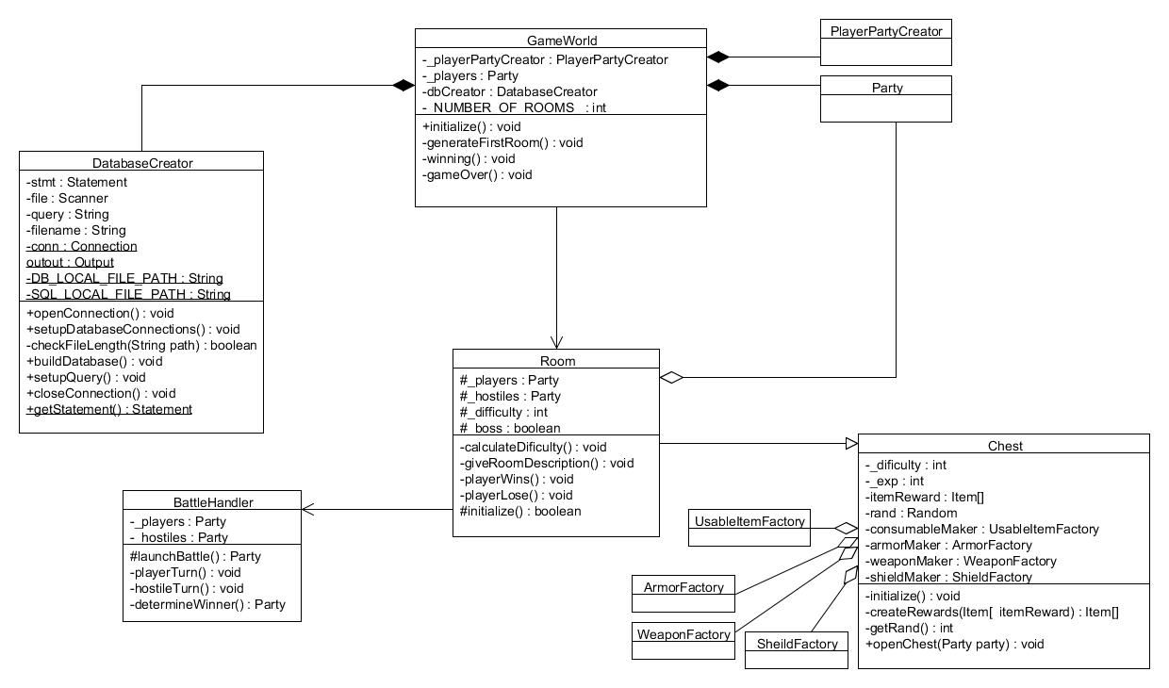

Slide 12
Character

Slide 13
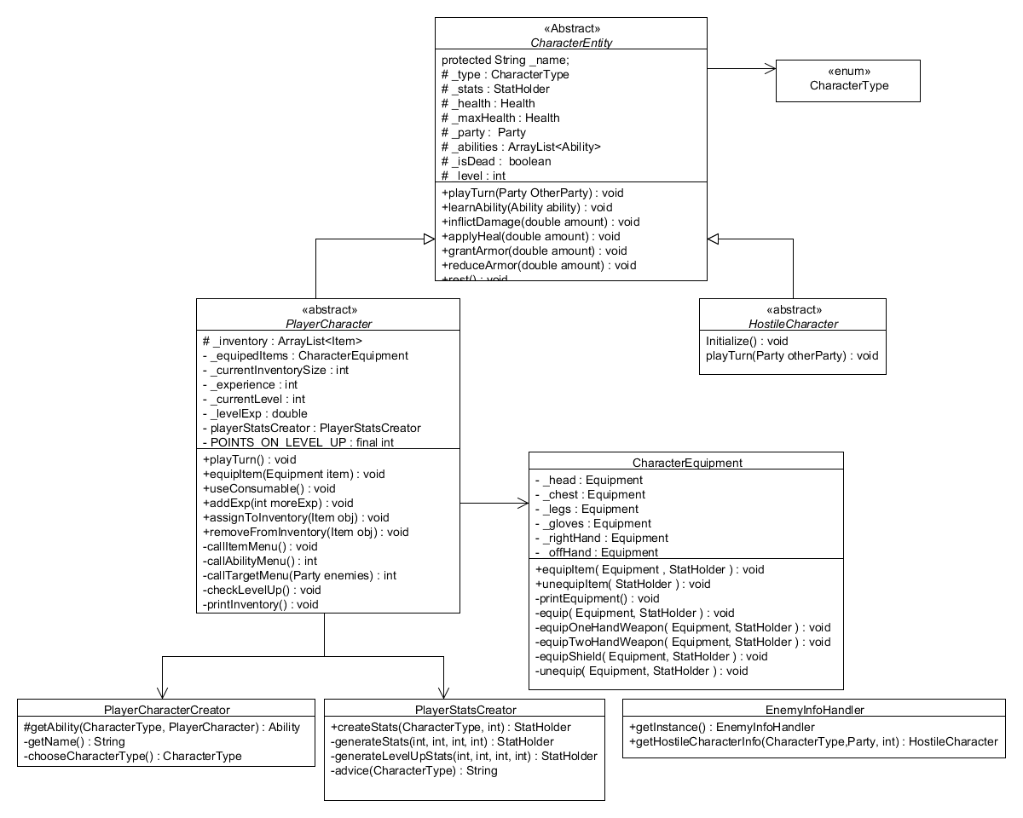

Slide 14
Demo

